Slide 1
PWA-Progressive Web Applications
A progressive web app (PWA) is an app that's built using web platform technologies, but that provides a user experience like that of a platform-specific app.
Example: Spotify’s PWA checks all the boxes. It is lightweight, can function offline, provides an immersive user experience, and serves up customized playlists, which it builds based on a consumer’s listening habits.

Slide 2
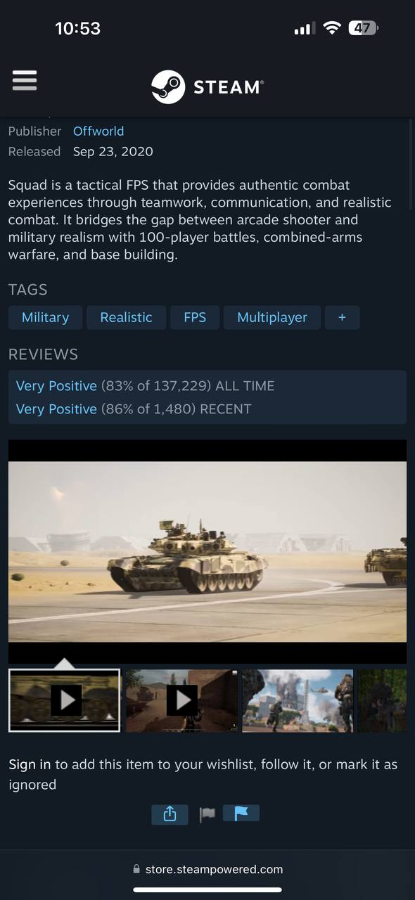
Steam
1. Data Usage: Steam’s website uses a lot of our data because of its content, these contents include promos, trailers, and game posters.
2. No Offline Access: Steam’s website doesn’t work when you are offline users aren’t able to access their games, community forums and stores.

Slide 3
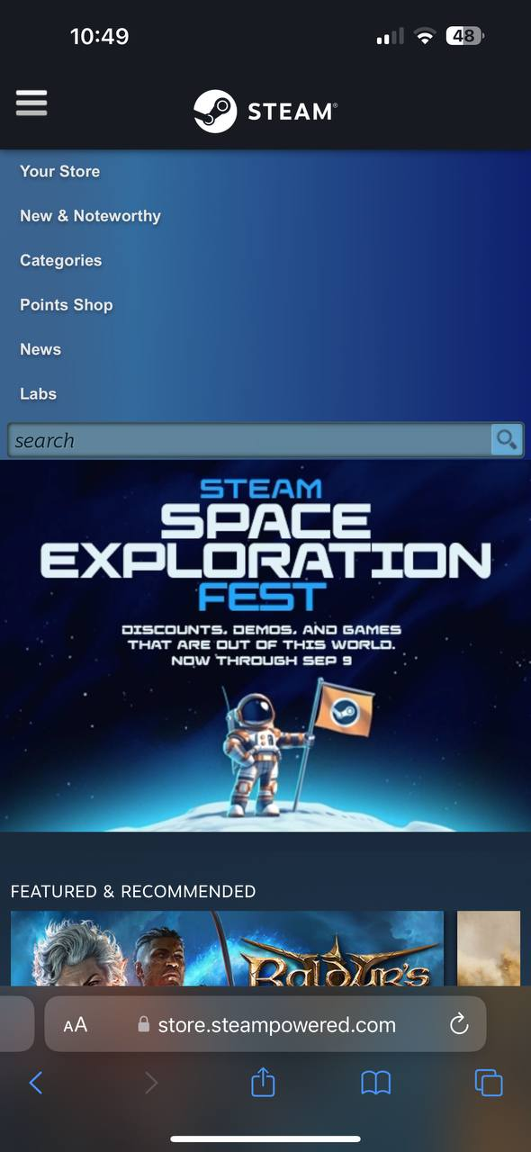
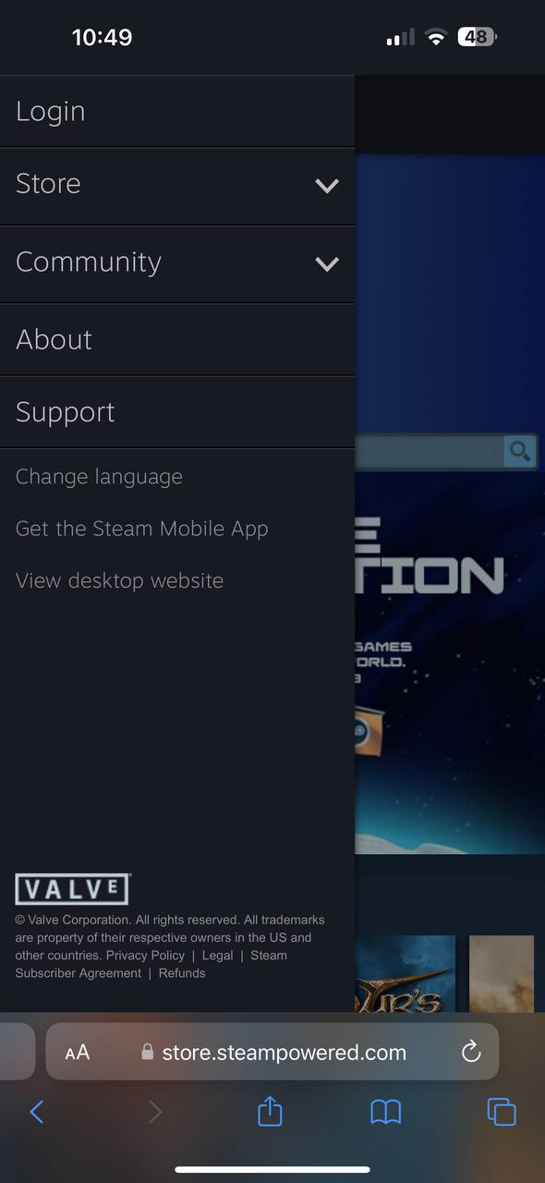
Steam
3. Mobile Design: Steam’s mobile web design is good but can definitely improve on the menu bar where the menu bar can cover almost the whole screen on some devices with a small screen.

Slide 4

FHSU
Data Usage: FHSU’s website can be data usage intensive since the first page of the website is the auto-played trailer of the university. Although it is good for the design, it can be hard to access when devices have low services.

Slide 5
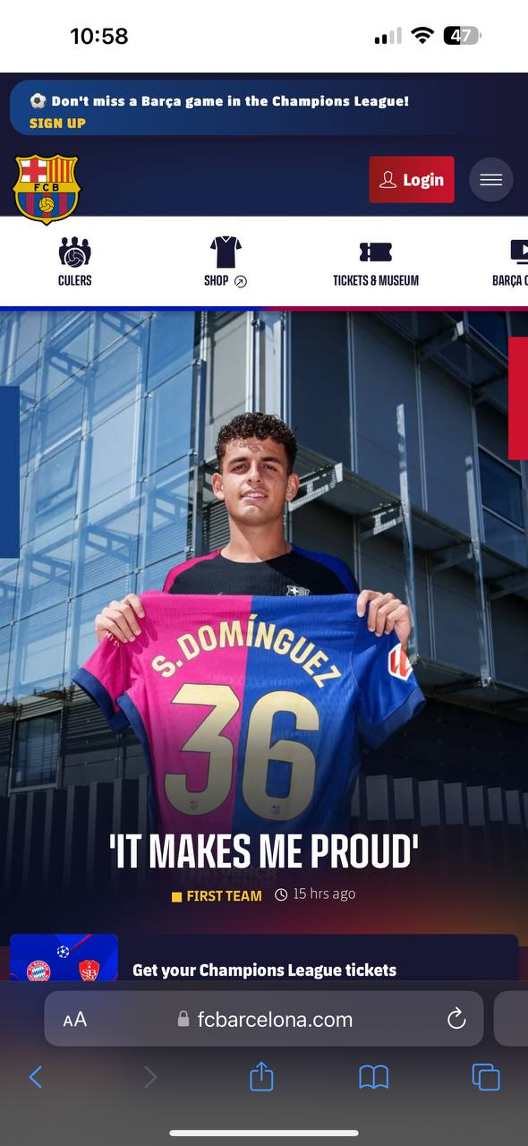
FC Barcelona
Mobile Design: While it is mobile user-friendly because of it’s many media contents there are some problems such as the top menu where you have to scroll left or right to see more menu options instead of all of it being there

Slide 6
Benefits of PWA Conversion
Reduced Data Usage and Offline Usage
Mobile Design Improvement
Using PWA allows caching of page contents such as game libraries and shirt store, improving load times and data usage.
By caching key resources such as contact information, or catalogs can let the user experience important information on the website while being offline.
Using PWA can offer the website smoother navigation to smaller screen devices.
Implementing PWA would provide a more streamlined, app-like experience on mobile devices, eliminating issues like the top menu for the FC Barcelona page.

Slide 7
PWA Features to Implement
Service Workers for Offline Functionality: By implementing service workers for caching the key information can let the suer access the information without being online.
Progressive loading: By implementing progressive loading the university pages can load the important content first and progressively loading other contents. This would be good for performance on low-end devices.

